Slide 1
“Mobile App for Direct Market Access for Farmers”
University Project-II
Review-1
Batch Number:CSE-G51
Under the Supervision of,
Mr.Syed Mohsin Abbasi
Professor
School of Computer Science & Engineering
Presidency University
Roll number | Student Name
20211CSE0670 | L S Gagan
20211CSE0637 | Anjan G
2o211CSE0608 | Sanjana S
20211CSE0678 | Soundarya Sarashetti
20211CSE0662 | Apeksha Changoli

Slide 2
Introduction
Farmers often face challenges in accessing markets, leading to lower income due to middlemen. This gap restricts their ability to sell produce at fair prices.
Create a mobile application that connects farmers directly with consumers and retailers. The app should include features for listing produce, negotiating prices, and managing transactions, thereby reducing dependence on intermediaries.
Expected Solution: A user-friendly mobile platform that enables farmers to showcase their products and connect with buyers directly, enhancing their income potential.

Slide 3
Literature Review
References | Title | Year | Technology /methodology | Key findings | Application
[1] | E-Agriculture for Direct Marketing of Food Crops Using Chatbots. | 2020 | Rule-Based Chatbots, Data Collection & Analysis , AI-Driven Conversational Chatbots. | Increased Farmer-Buyer Engagement , Reduced Dependency on Middlemen, Improved Market Efficiency , 24/7 Availability. | Crop Price & Market Insights, Order Management, Smart Negotiation & Bidding, Weather & Pest Alerts.
[2] | Farm Connect Application: Bridging the Gap Between Farmers and Consumers Through Digital Technology". | 2023 | Mobile Application Development, AI & Machine Learning, sBlockchain Technology, IoT Integration, Digital Payment Systems. | Increased Farmer Income, Direct Consumer Access, Enhanced Market Transparency, Real-time pricing and demand insights improve decision-making. Challenges in Adoption. | Direct Farmer-to-Consumer Sales, Supply Chain Optimization, Financial Inclusion, Government & Policy Support.
[3] | Determinants of Small-Scale Farmers’ Intention to Use Smartphones for Generating Agricultural Knowledge in Developing Countries: Evidence from Rural India.. | 2021 | Survey Data Collection, Behavioral Model Analysis | Positive Influences, Emotional Factors. | Policy Development, Educational Programs

Slide 4
[4] | A Digital Solution for Agricultural Marketing: Implementation of AI-Based Crop Pricing Systems in Mobile Apps. | 2023 | Artificial Intelligence (AI) and Machine Learning (ML), Mobile Application Development, Blockchain Technology. | Improved Pricing Accuracy Increased Farmer Profitabilit, Market Transparency. | Direct Farmer-to-Consumer Sales via mobile platforms.Optimized Supply Chain Management with accurate pricing data.Financial Planning & Risk Management for farmers.Policy Insights for fair pricing strategies..
[5] | Blockchain-Based Secure Mobile Application for Direct Farmer-to-Consumer Trade. Journal of Agricultural Informatics. | 2022 | Blockchain Technology, Smart Contracts, Cryptographic Techniques. | Enhanced Situational Awareness, Improved Safety Management. | Direct Sales Platform, Supply Chain Management, Quality Assurance

Slide 5
Objectives
Eliminate Middlemen – Provide a direct connection between farmers and consumers/retailers to ensure fair pricing.
Increase Farmer Income – Help farmers earn better profits by selling directly to buyers.
Enhance Market Reach – Expand farmers' market access beyond local regions using a digital platform.
Simplify Transactions – Implement an easy-to-use system for listing produce, negotiating prices, and managing payments.
Provide Market Insights – Offer real-time price trends, demand forecasts, and weather updates for informed decision-making.
Enable Secure Transactions – Integrate safe and reliable payment gateways for smooth financial transactions.
Support Multiple Languages – Ensure accessibility for farmers with different linguistic backgrounds.

Slide 6
Methodology
Technology used
Frontend: React Native, HTML , CSS and JavaScript
Backend: Php
Database: MySQL for data storage.
Payment Integration: Paytm, Stripe
Geolocation: Google Maps API

Slide 7
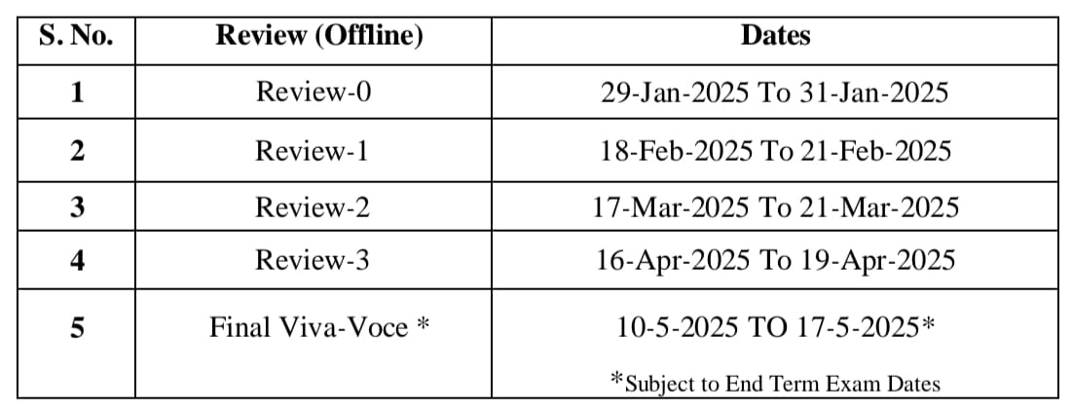
Timeline of Project

Slide 8
Expected Outcomes
Increased Farmer Profits – Farmers will have better pricing power by selling directly.
Improved Market Access – More buyers and sellers will be able to connect beyond local areas.
Faster Transactions – Digital payments and automated order management will speed up sales.
Better Inventory & Order Management – Farmers will be able to track their stock and fulfill orders efficiently.
User-Friendly Platform – A simple and accessible interface for both farmers and buyers.
Sustainability & Reduced Waste – Direct selling can reduce post-harvest losses by enabling faster transactions.

Slide 9
Conclusion
The Mobile App for Direct Market Access for Farmers is a transformative solution designed to empower farmers, eliminate middlemen, and ensure fair pricing. By leveraging technology-driven features, the app enables farmers to directly connect with consumers, retailers, and businesses, significantly enhancing their income potential.
By creating a transparent, efficient, and farmer-friendly digital marketplace, this app has the potential to revolutionize the agricultural sector, making it more sustainable, profitable, and accessible for all stakeholders involved.

Slide 10
References
[1]. Usha kruthika, S. S. (2020). E-Agriculture for Direct Marketing of Food Crops Using Chatbots. Chennai,India. doi:10.1109/ICPECTS49113.2020.9337024.
[2]. P, V., P, R., S, K. S., Rao, P. M., & T.A., V. P. (2023). "Farm Connect Application: Bridging the Gap Between Farmers and Consumers Through Digital Technology,". Ghaziabad, India,. doi: 10.1109/ICSEIET58677.2023.10303471.
[3] Landmann, D., Lagerkvist, C. J., & Otter, V. (2021). Determinants of Small-Scale Farmers’ Intention to Use Smartphones for Generating Agricultural Knowledge in Developing Countries: Evidence from Rural India. The European Journal of Development Research, 33, 1435–1454
[4] Gupta, R., & Verma, S. (2023). A Digital Solution for Agricultural Marketing: Implementation of AI-Based Crop Pricing Systems in Mobile Apps. Proceedings of the 10th International Conference on Sustainable Development in Computing Technology.
[5]. Sharma, P., & Kaur, R. (2022). Blockchain-Based Secure Mobile Application for Direct Farmer-to-Consumer Trade. Journal of Agricultural Informatics, 13(2), 75-89. DOI: 10.17700/jai.2022.13.2.659.

Slide 11
Thank You

